Slide 1


Actor-Critic Gridworld
Group 12
Akhil Vallala
Bethany Brown
Jhansy Harshitha Vankayalapati
Oasis Husband

Slide 2
Introduction
Reinforcement Learning is a ML algorithm that helps choose the optimal path by rewards and punishment. The goal is to maximize the reward (Kadari)
A gridworld is a matrix of a specified shape that contains walls, edges, and a start and end state. The agent must navigate from start to end without moving through the walls or exiting the maze
This project focused on the Actor-Critic network which is a Temporal Difference Algorithm that uses an Actor and a Critic to allow the critic to tell the actor how good the action the algorithm took was (Karunakaran0
The Actor-Critic Network requires input on what actions to take and what results it will give. The action chosen is either the action with the highest score or a random action that was ‘tested’ to see if it had a higher score. After repeating for several epochs, it can coverge to the highest-scoring set of actions

Slide 3

Problem Formulation
Grid world problem using Actor-Critic Network
The state of the game is the position of the agent as it traverses the path from the initial to goal state
The agent has four actions: up, down, left, and right, signified by the symbols, '^', 'v', '<', and '>’.
There are four rewards based on whether the agent is at a step, a pit, the goal or the number of moves is greater than the maximum number of moves
Each maze has a max of 40 moves so the actor does not get stuck in an eternal loop
Step: 0, Pit: -9, Goal: +10, Max Number of Moves: -10
Notes:
'P' is the player, 'W' is a wall, '-' is a pit, and '+' is the end.
Player step: If a player moves into an empty, yet new location, this is not rewarded, but also not punished.
Pit: If a player runs into the pit, it is an automatic fail-terminal state, and the player gets a score of -9.
Goal: If a player reaches the goal, it is abundantly rewarded with a score of +10.
Max number of moves: If the player runs out of time, it is punished the most, with a score of -10.

Slide 4
Method Design
The Actor-Critic Network uses two networks: the policy network (the Actor) and the value network (the Critic)
The policy network is essentially the same as the Q-learning network
The Critic network is similar to the policy network but only produces a single value: the score for the input state
Both are Neural Networks
A ‘test’ was created to use the model using only the policy network was used
Objective of the Critic network is to estimate value function using TD algorithm
The design of our model includes three sections: Easy, Medium, Hard
Easy: player and obstacle locations do not change between epochs
Medium: the player is randomly set between epochs
Hard: randomly set except for end goal
Focus on Easy version
Notes:
During the test, the forward pass is used to calculate the predicted Q-values for the given state and the loss as the MSE between the predicted and target Q-values. RMSprop is used for updating the weights based on gradients

Slide 5
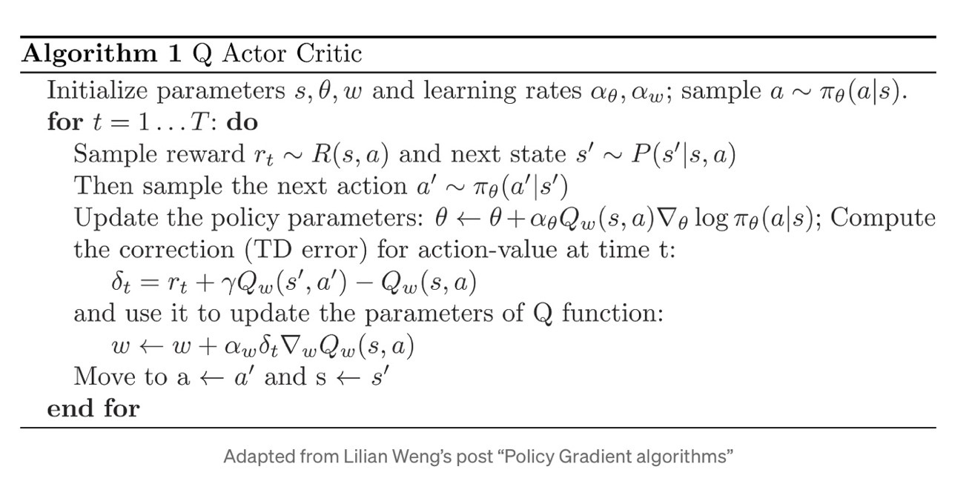
Actor Critic Algo
Actor method is a policy based method and critic is a value bases method. We have two separate neural network for these two. Actor picks the action and critic tells how good that action is.
Notes:
Actor method is a policy based method and critic is a value bases method. We have two separate neural network for these two. Actor picks the action and critic tells how good that action is.
To train the critic network, we use a simlar process to training value into Q networks. We look at the initial state, make a move, and then look at the new state. For the value network, if we are in a terminal state, that's the value we tell the value network to place on that state. If we are in a non-terminal state, we tell the value network to place a value on the original state which is the reward in the original state, plus the discounted value from the new state. Note that the value network should return the maximum possible value for a given state. If the player's next move could be either jumping into the pit or arriving at the goal, we should set the value as if the best-possible action will be selected.
After the critic network has assigned a value to the original and the new state, we adjust the policy. This is simply by looking at our value in our old state, and the value in the new state. If the value improves we encourage that action. If it decreases we discourage the action.
When we start training, both the actor and the critic networks are spitting out nonsensical values. Which means initially the actor network is training on values from the critic network which are garbage. However as the critic network improves, those improvements naturally correct and improve the performance of the actor network.

Slide 6
Pseudocode
Parameters: game_type, epochs, batchsize, gamma, epsilon, min_epsilon, buffer, earlystop
Key Components and Flow
Initialization and Replay Buffers
Environment Setup
Training Loop
Learning
State Update
Epsilon Decay
Early Stopping
Output
Model Training
Notes:
The `trainer` function in the provided code is designed to train a reinforcement learning (RL) model using an actor-critic approach. The function has multiple parameters that customize the training process and can handle different complexity levels in the game environment (easy, medium, hard). Below, I'll explain the function's parameters, main blocks, and the overall training loop:
### Parameters
- `game_type`: Determines the initial state of the game. It could be 'easy', 'medium', or 'hard', affecting how the initial game state is set up.
- `epochs`: The total number of training iterations (or episodes).
- `batchSize`: Number of samples used in each batch during training of the models.
- `gamma`: The discount factor used in the update equations, to calculate the future discounted reward.
- `epsilon`: The exploration rate in the epsilon-greedy strategy, starting value.
- `min_epsilon`: The minimum value epsilon can decay to over training, ensuring some level of exploration.
- `buffer`: Size of the memory buffer that stores past experiences.
- `earlystop`: The early stopping criterion based on win percentage.
### Key Components and Flow
1. **Initialization and Replay Buffers**:
- Initializes variables and lists for storing actor and critic experiences.
- Sets early stopping criteria.
2. **Environment Setup**:
- Depending on the game type, the initial state of the game grid is set.
3. **Training Loop (Epochs)**:
- For each epoch, the game is played until a terminal state is reached (status != 1).
- At each step of the game:
- An action is chosen either randomly (with probability epsilon) or based on the policy derived from the actor model (Q values).
- The chosen action is applied to the environment to get a new state and reward.
4. **Learning**:
- **Critic Update**: Learns the value of state-action pairs. If the replay buffer has enough data, it samples a minibatch and performs a fit operation on the critic model.
- **Actor Update**: Updates the policy based on the error (delta) between critic predictions for the old and new state values. If the actor's buffer is sufficiently filled, it also samples and updates the actor model.
5. **State Update**:
- Updates the game state and checks for terminal condition. If a terminal state is reached, it checks for a win or loss to update an accumulated win percentage for early stopping.
6. **Epsilon Decay**:
- Reduces epsilon gradually to decrease exploration over time.
7. **Early Stopping**:
- If the accumulated win percentage exceeds the set threshold (`earlystop`), the training stops early.
8. **Output**:
- After each epoch, the function outputs the current game number and the accumulated win percentage. This helps in monitoring the progress.
### Model Training
- The critic model learns to estimate the true value of each state by minimizing the difference between estimated values and observed rewards.
- The actor model adjusts its policy towards actions that lead to higher future rewards as estimated by the critic.
The provided function showcases a typical implementation of an actor-critic method in RL, using separate models for policy (actor) and value estimation (critic), and incorporates techniques like experience replay, epsilon-greedy exploration, and early stopping based on performance.

Slide 7
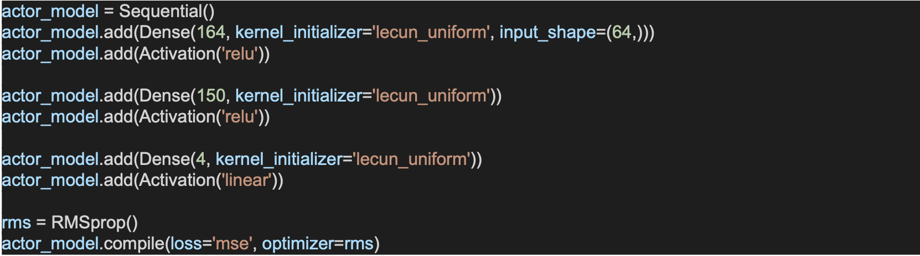
Actor Network
The NN of the Actor Network contains a
Input Layer representing the states in the maze which is 64(4*4),
The Hidden Layers consist of 164 and 150 units which are followed by a ReLU activation function, and a
Output Layer which corresponds to the action that the agent needs to take with a size of 4 units with a linear activation function.

Slide 8
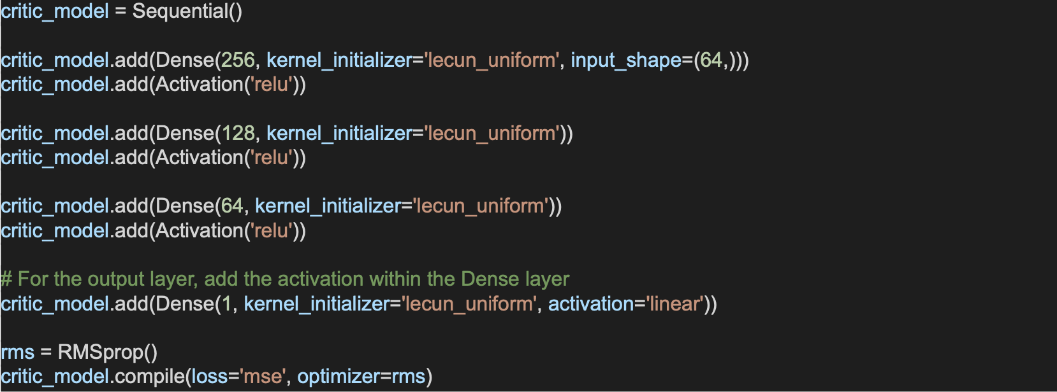
Critic Network
The NN of the Critic Network contains a Input Layer, the states in the maze which is 64(4*4), the Hidden Layers consist of 256, 128, and 64 units which are followed by a ReLU activation function, and the Output Layer which corresponds to the estimated state-action value of 1 unit with a linear activation function.

Slide 9
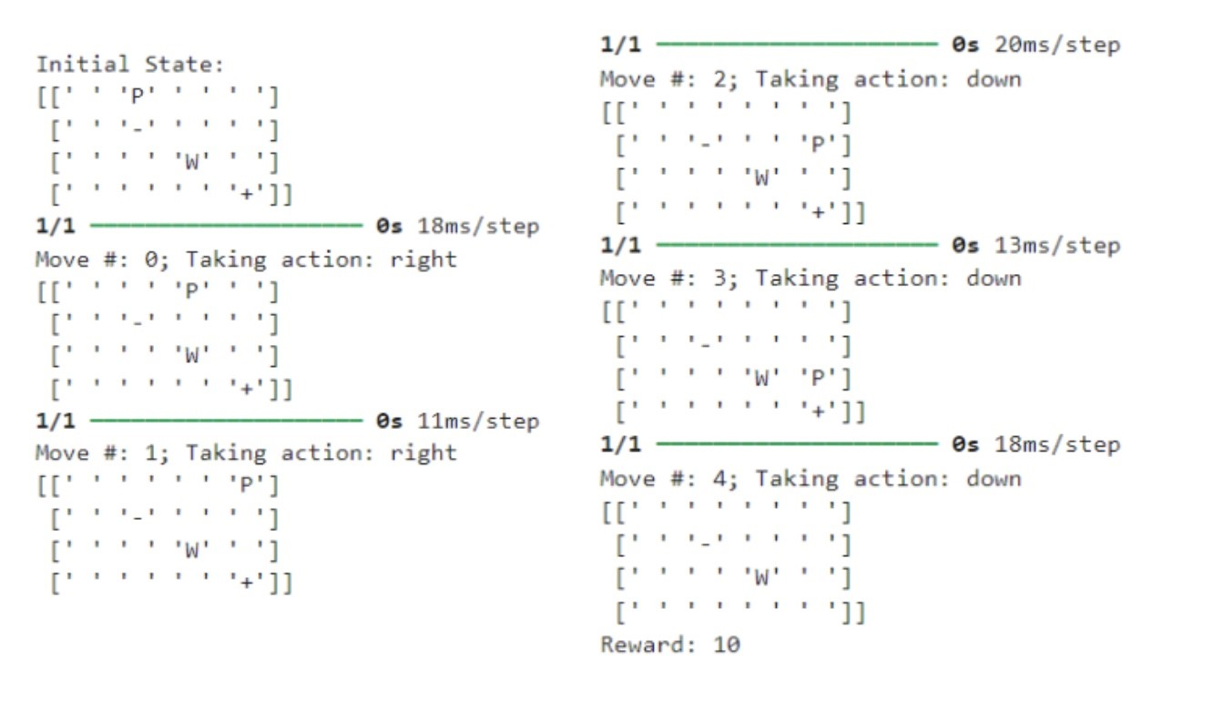
Experiment-Easy Game Environment
In the beginning of training, the Player moves randomly and learns from the best results of code
Through the epochs, the agent is taught by the correct and sensible results that allow the Player to move toward the goal
The Player proceeds to move right, go down three time, while ignoring the pit and navigating around the wall to get to the end state. Finally, it receives a reward of 10

Slide 10
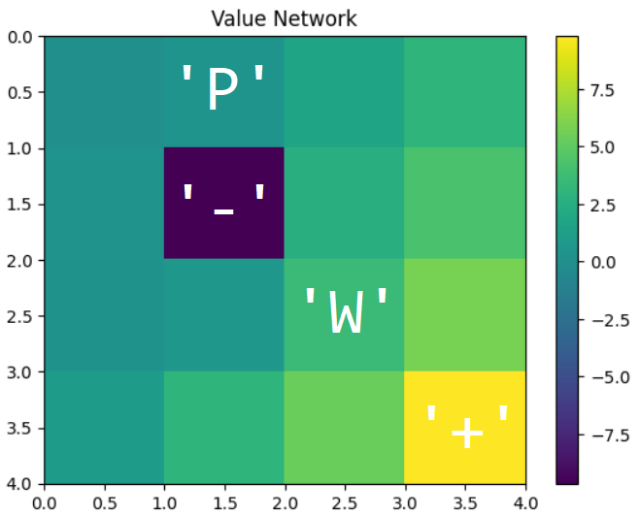
Experiment-Easy Game Environment
After 273 epochs, the actor learns the correct moves to reach the goal as seen by the Value network
Agent has ascribed certain levels of value to each move
Pit is very negative(‘-’): Agent will never be able to receive more than a 9
Approaching the Win Condition (‘+’), it becomes brighter and brighter until it enters the win state

Slide 11
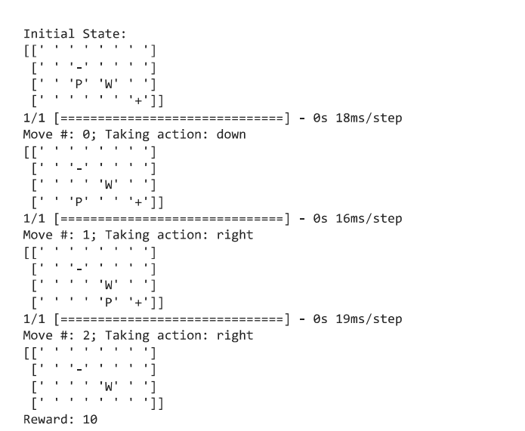
Experiment-Medium Game Environment
In the Medium game environment, the position of the Player is chosen at random.
Through the epochs, the agent is taught by the correct and sensible results that allow the Player to move toward the goal
The Player proceeds to move down, go right two times, while ignoring the pit and navigating around the wall to get to the end state. Finally, it receives a reward of 10

Slide 12
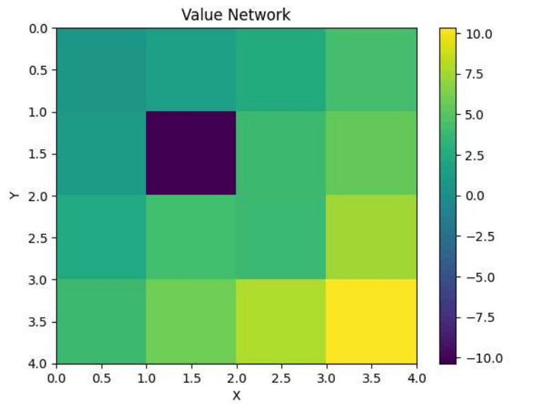
Experiment-Medium Game Environment
After 150 epochs, the actor learns the correct moves to reach the goal as seen by the Value network
Agent has ascribed certain levels of value to each move
Pit is very negative(‘-’): Agent will never be able to receive more than a 9
Approaching the Win Condition (‘+’), it becomes brighter and brighter until it enters the win state

Slide 13
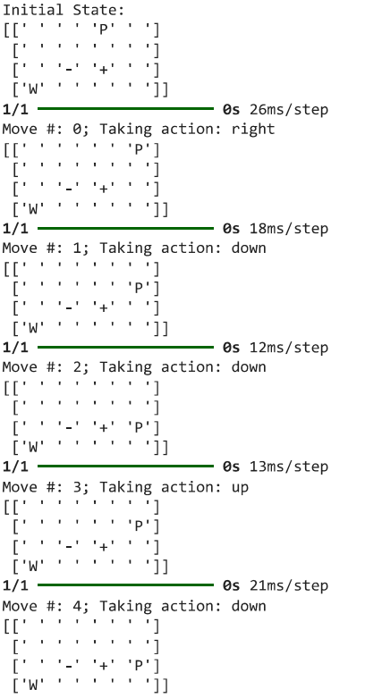
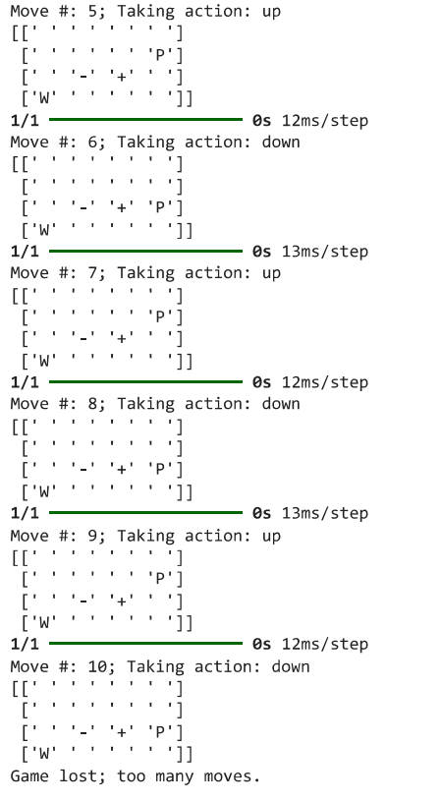
Experiment-Hard Game Environment
In the Hard game environment, the position of the Player, Wall, Pit and Goal are chosen at random.
Through the epochs, the agent is taught by the correct and sensible results that allow the Player to move toward the goal
After Move 4, the Player is stuck in a loop, moving up and down simultaneously, exceeding the number of moves limit, and finally losing the game.

Slide 14
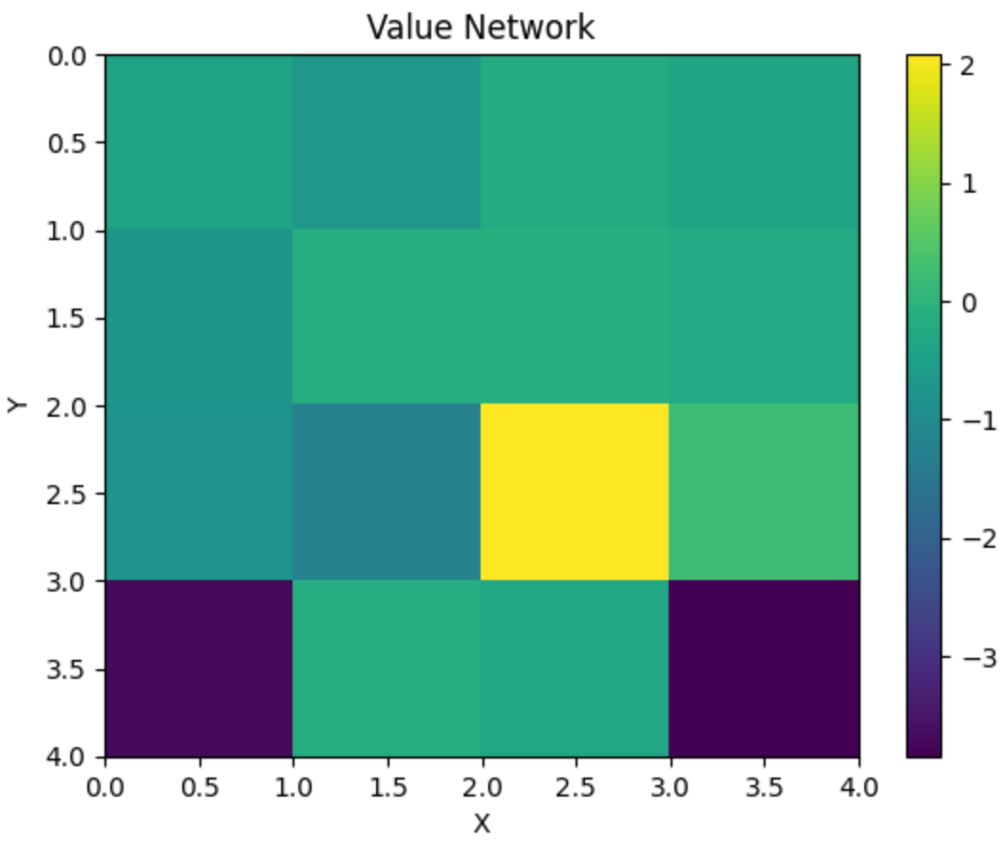
Experiment-Medium Game Environment
Even after 1000 epochs, the actor does not learn the correct moves to reach the goal as seen by the Value network
Agent has ascribed certain levels of value to each move
Pit is very negative(‘-’): Agent will never be able to receive more than a 9
Approaching the Win Condition (‘+’), it becomes brighter and brighter until it enters the win state

Slide 15
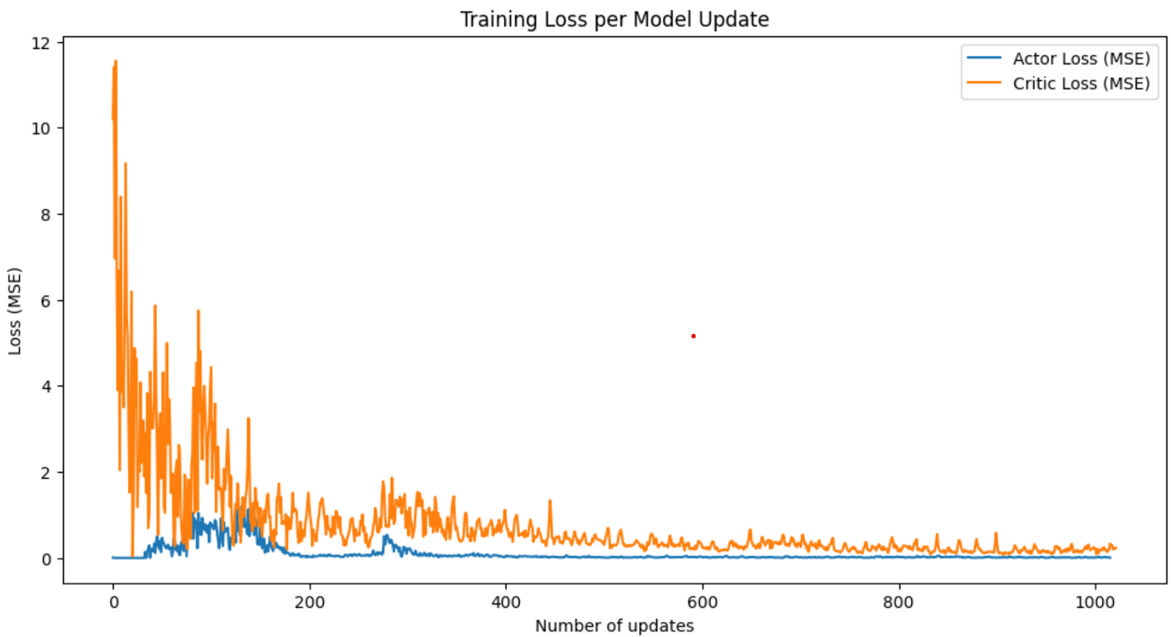
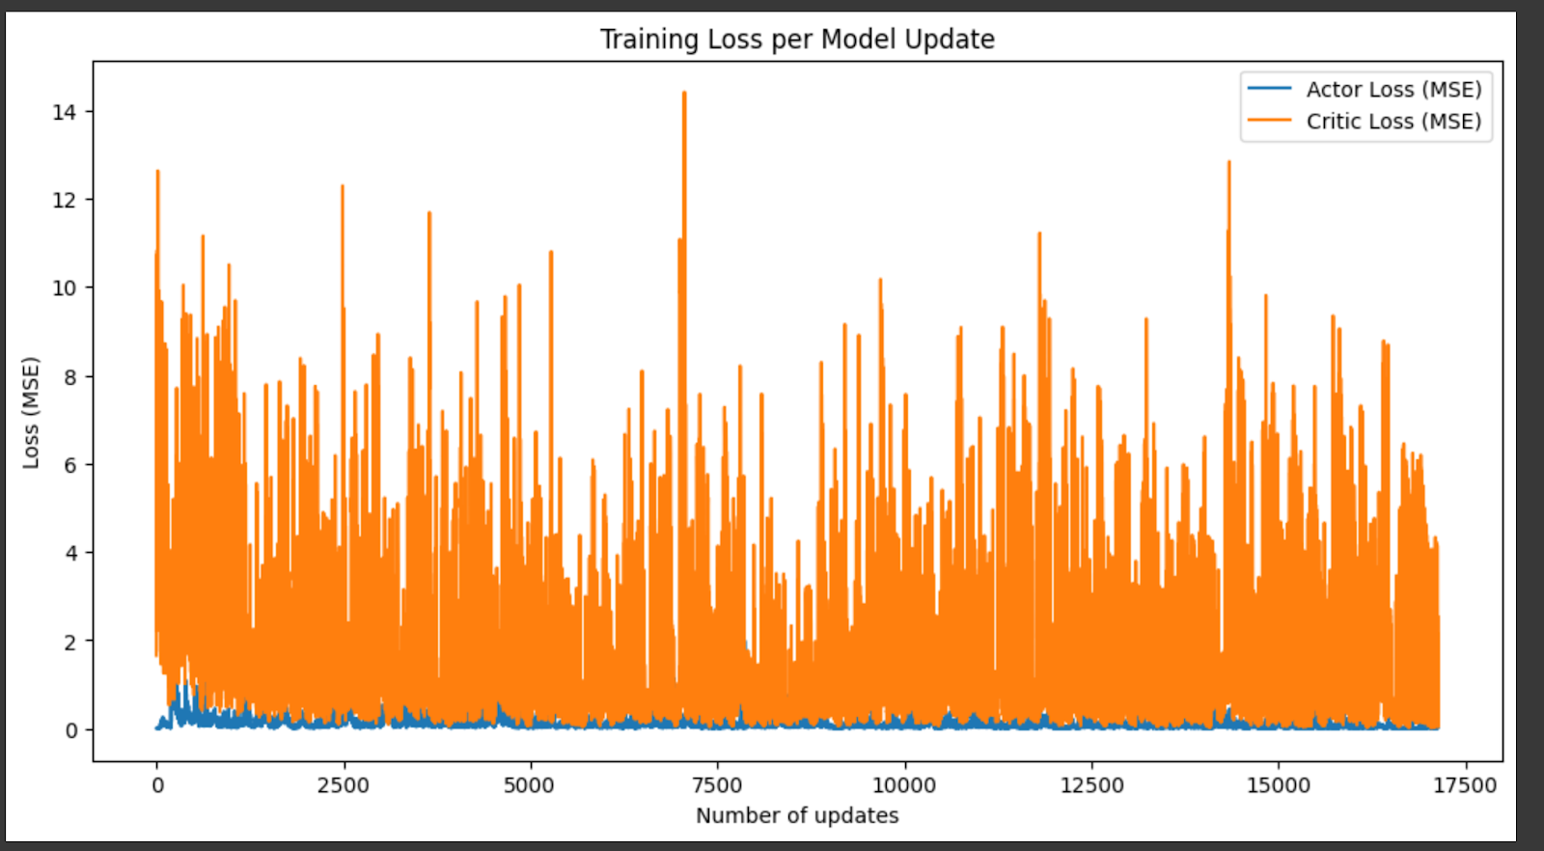
Results
Easy
The losses are converging over the time- period, therefore minimizing the error and improving the performance over each epoch
Medium
Losses are converging. Therefore minimizing errors and improving performance
Hard
Losses have not converged over the time-period

Slide 16
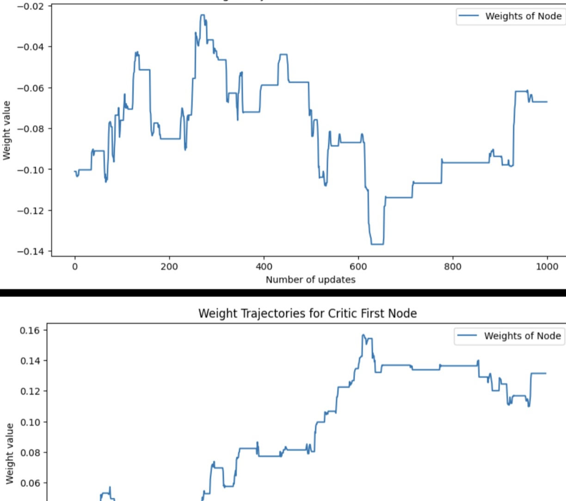
Results
Easy and Medium
The weight projectories of the first node of both the Actor and Critic network
The straight line indicates that the weights are constant and converging
Hard
The figure does not indicate that the weights are converging
Model needs to be trained for more episodes

Slide 17
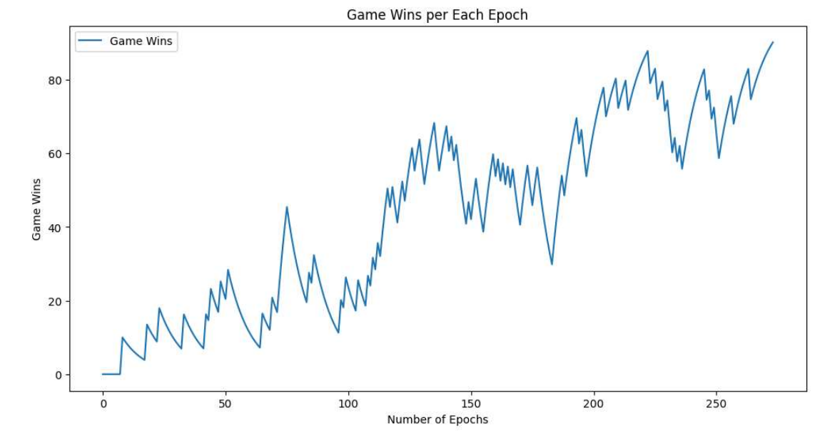
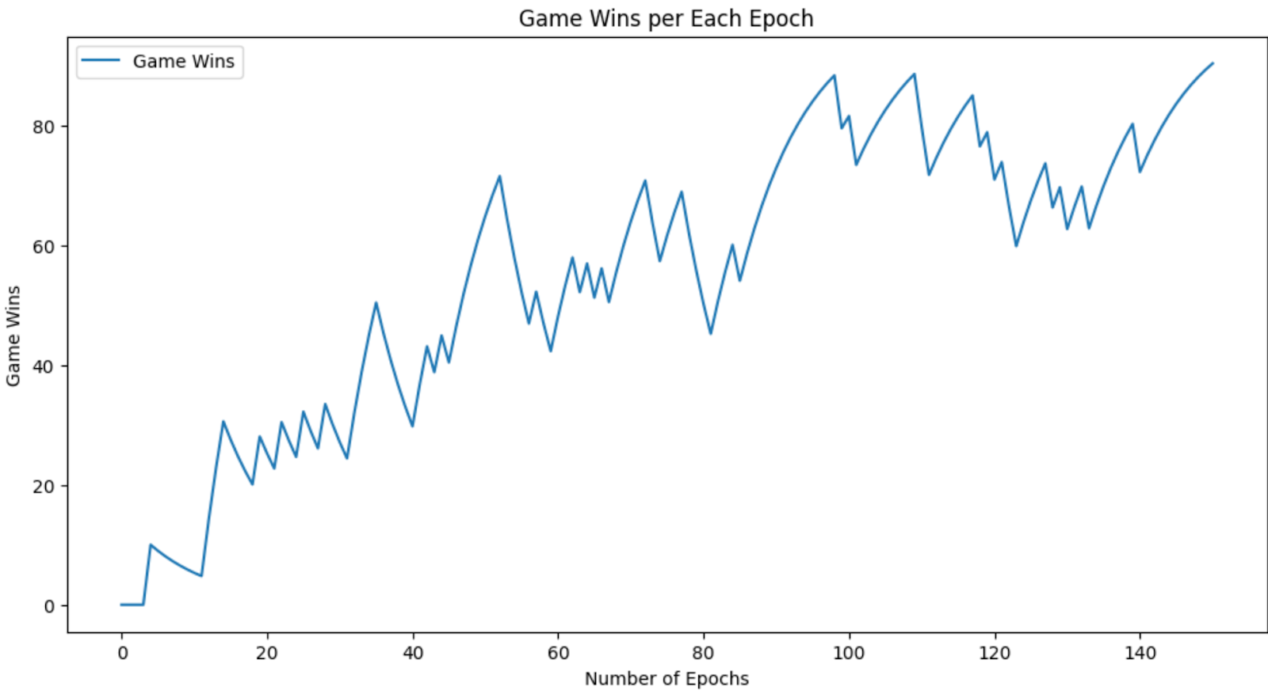
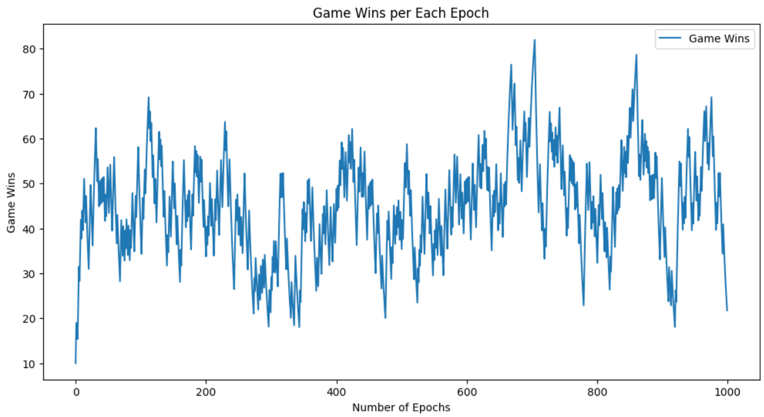
Results
The figure shows the wins per epoch
Easy
At the 273rd epoch, the win percentage was 90.21%
Medium
At 150th epoch, the win percentage was 90.31%
Hard
At 700th epoch, the win percentage was 80%
Notes:
For the easy and medium experiments, the win percentage was greater than the early stopping percentage which indicates that the Player has learned the policy to avoid the wall and pit. But for the hard experiment, the player has not learned the policy as the win % is greater than the early stopping percentage

Slide 18
Downfalls of Action-Critic Architecture
Actor-critic architecture is not effective in every situation
In the Hard version of the maze where the pit, wall, and player are randomly set after each epoch, it is nearly impossible for the Player to understand how to move around them
Demonstrated by the Hard Architecture
The Player cannot see in front of itself
If the state the actor is learning from is random, it cannot accurately learn
For example, say the pit is in front of the actor. It enters it and receives a heavy penalty. In the next epoch, it sees the location of the pit, sees the negative score, and decides to move in the opposite direction. However, this time, the pit was at that location! So, it receives another negative penalty, when the original negative spot would have been safe to begin with. As such it makes it impossible for the Player to learn where the correct place to move is.

Slide 19
Conclusion
Action-critic architecture is very effective as a simple to learn and easy to use program
The Experiment highlights the usefulness of the network in training the Actor to navigate the maze
Random exploration to specifically trained movement with purposeful navigation
Further research can be done to enchance the Actor-critic’s ability in new locations, ultimately broadening its applicability to real-world problems, such as control of a human arm (Philip et. all), or when walking on a cliff (Zhang).

Slide 20
Roles
Akhil
Edited the code used for the project for easier implementation.
Bethany
Writer of the report
Assisted with actor structure creation
Wrote the majority of the PowerPoint
Jhansy
Writer of the report
Assisted in training the Easy and Medium game environments.
Assisted with the PowerPoint
Oasis
Writer of the report
Assisted with the code of Medium and Hard difficulties

Slide 21
References
Kadari, P. (2024, February 21). What is reinforcement learning and how does it work (updated 2024). Analytics Vidhya. https://www.analyticsvidhya.com/blog/2021/02/introduction-to-reinforcement-learning-for-beginners/
Karunakaran, D. (2020, September 30). The actor-critic Reinforcement Learning Algorithm. Medium. https://medium.com/intro-to-artificial-intelligence/the-actor-critic-reinforcement-learning-algorithm-c8095a655c14
Thomas, P., Branicky, M., van den Bogert, A., & Jagodnik, K. (2009). Application of the actor-critic architecture to functional electrical stimulation control of a human arm. Proceedings of the ... Innovative Applications of Artificial Intelligence Conference. Innovative Applications of Artificial Intelligence Conference. https://www.ncbi.nlm.nih.gov/pmc/articles/PMC2916188/
Yoon, C. (2019, February 5). Understanding actor critic methods and a2c | by Chris Yoon | towards data science. townrdsdatascience.com. https://towardsdatascience.com/understanding-actor-critic-methods-931b97b6df3f
Zhang, J. (2019, June 22). Reinforcement learning - cliff walking implementation. Medium. https://towardsdatascience.com/reinforcement-learning-cliff-walking-implementation-e40ce98418d4

